Slide 1


Welcome To Our Presentation

Slide 2
Group Members
Md. Robel Mia
152-15-5538
Mahadi Hasan Mazumder
152-15-5797
Awolad Hossain
152-15-5536
Shahabuddin Bhuiyan
152-15-483

Slide 3
OUR Project TOPIC
Plants Monitor – Arduino Soil Moisture Sensor

Slide 4
INTRODUCTION
A soil moisture sensor measures the quantity of water contained in a material, such as soil on a volumetric basis.
That means it can detect amount of moisture in soil (roots of a plant).
It is Low-Tech sensor.
This sensor is compatible with Arduino UNO, Arduino mega2560, Arduino ADK etc.

Slide 5
Motivation
The motivation for doing this project was primarily an interest in undertaking a challenging project in an interesting area.
The opportunity to learn about a new area of computing not covered in lectures was appealing.
This area is possibly an area that I might study at postgraduate level.

Slide 6
Objective
This sensor has low power consumption, and high sensitivity.
Operates on low Voltage of 5v.
Operates on low current <20mA.
Weighs only 3 gram.

Slide 7
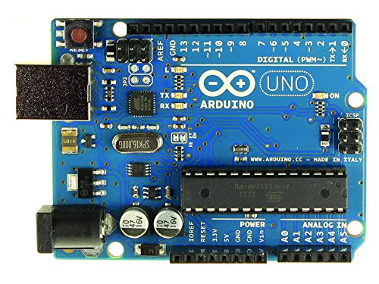
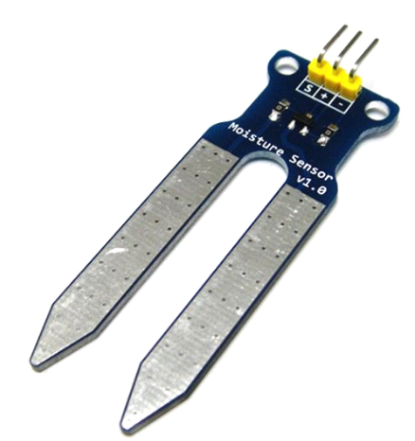
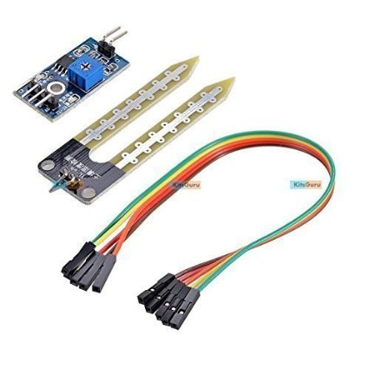
Hardware required
Arduino UNO
Soil Moisture Sensor
Female Jumper wire
LED, Sensor shield (Optional, not required)
Arduino UNO
Female Jumper Wire
Soil Moisture Sensor

Slide 8
Connecting Diagram
Soil Moisture Sensor connected to Arduino

Slide 9
Working Principle
Strictly Speaking moisture sensor does not measures moisture but measures conductivity or resistivity of soil.
Moisture Sensor has two probes to pass current through the soil. It then reads resistance(conductance) in the soil.
Less moisture (water) in soil results in higher resistance i.e. dry soil.
More moisture (water) in soil results in lesser resistance and sensor thus relates moisture content.

Slide 10
Challenges
Depth of detection is only 37mm.
Working temperature is only 10˚-30˚ Celsius.
Less accuracy.

Slide 11
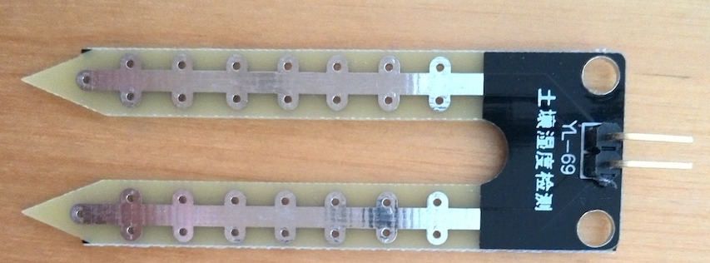
YL-69 Moisture Sensor (Probes)
YL-69 (Probes)

Slide 12
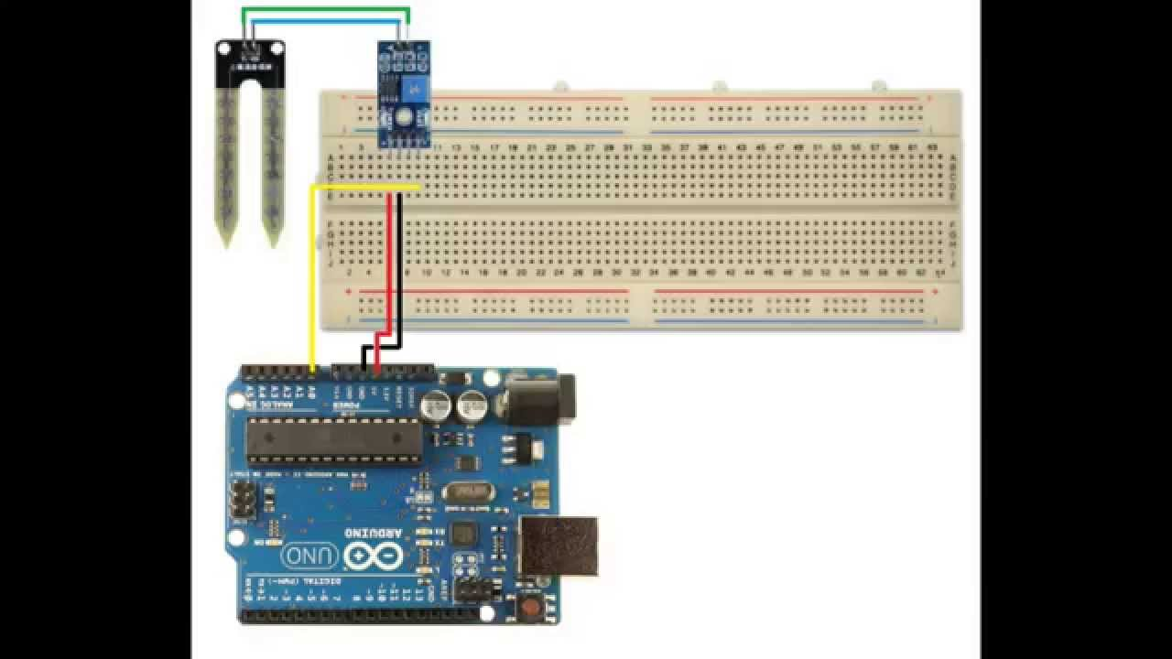
Pictographic Representation
Soil Moisture Sensor connected to Arduino

Slide 13
Future Works
Huge area recover
Applied in big field

Slide 14
Budget
Total budget: 2,000 taka (approximately)

Slide 15

Any Question

Slide 16
Thank You ☺

